Slide 1
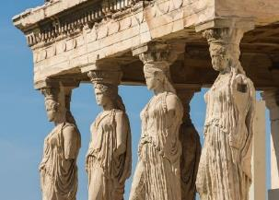
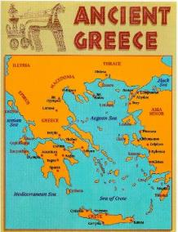
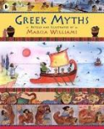
Ancient Greeks KS2 Knowledge Mat
Subject Specific Vocabulary |  |  | Where is Greece?
philosophy | Philosophy is a way of thinking about the world, the universe, and society.
Athenians | It is the birth place of democracy and the heart of the Ancient Greek civilisation.
Spartans | The Spartans believed that strict discipline and a tough upbringing was the secret to making the best soldiers.
democracy | Democracy means allowing citizens to make their own decisions for their personal lives.
 |  | Sticky Knowledge about Ancient Greece
Olympics | The ancient Olympic Games were originally a festival, or celebration of Zeus.
plague | The plague of Athens was an epidemic illness that devastated the city. | The Ancient Greeks invented the theatre because they loved watching plays, and most cities had a theatre.
truce | A truce is when two fighting sides declare peace or a break in the war. |  | Exciting Books
 |  | Events at the Greek’s Olympics included wrestling, boxing, long jump, javelin, discus and chariot racing.
Zeus | The supreme god of the Olympians, Zeus was the father of Perseus and Heracles.
loincloth | A single piece of cloth wrapped round the hips, typically worn by men in some hot countries as their only garment. | The Ancient Greeks held many festivals in honour of their gods.
 |  | Most Ancient Greeks wore a chiton, which was a long T-shirt made from one large piece of cotton. The poor slaves, however, had to make do with a loincloth.
Apollo | Apollo was the god of music, truth and prophecy.
sacred truce | A special truce called whilst the Olympics were taking place.
temple | A building devoted to the worship of a god or gods.

Slide 2
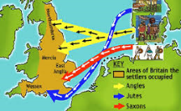
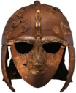
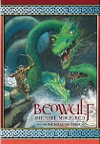
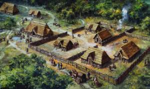
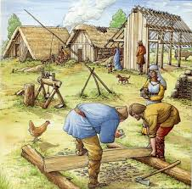
Anglo-Saxon: KS2 Knowledge Mat
Subject Specific Vocabulary |  |  | Exciting Books
archaeologist | People who discover our history by looking at artefacts that have been found.
Anglo-Saxon kingdoms | The Anglo-Saxons formed many regions each with one ruler, known as kingdoms.
shires | Saxon lands were divided into shires, which helped to make up the counties we have today
 |  | Sticky Knowledge about the Anglo-Saxons
Shire reeve | The peace officer of a shire, later known as ‘sheriff’. |  | Anglo-Saxon Settlements
 |  | The Anglo-Saxons were made up of three tribes: the Angles; Saxons; and Jutes.
thane | An important Anglo-Saxon person.
legacy | Anglo-Saxons left a legacy which included the language we speak, culture and politics. Many of the shires are our boundaries for counties today. | The name ‘Angles’ eventually became ‘English’ and their land, ‘Angle-land’, became ‘England’.
 |  | They came to Britain from across the North Sea in the middle of the 5th Century.
Wessex | Known today as Dorset, Hampshire, Somerset and Wiltshire. | For a long time, England was not one country. Anglo-Saxon kings ruled lots of small kingdoms across the land.
Witan or witenagermot | A council that helped the Saxon king rule. | The Anglo-Saxons were fierce people who fought many battles, including fighting each other.
wergild | A fine imposed for stealing or killing. | The Anglo-Saxon period ended when the Normans conquered Britain in 1066.
churl | A lower-class Anglo-Saxon but better than a slave.
Mercia | Known today as East Anglia, Essex, Kent and Sussex.

