Slide 1
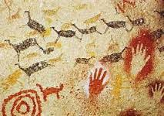
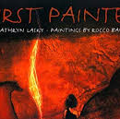
Stone Age KS2 Knowledge Mat
Subject Specific Vocabulary |  |  | Exciting Books
archaeologists | People who discover our history by looking at artefacts that have been found.
artefact | An object made by human beings, usually with historical or cultural interest.
Neolithic | The later part of the Stone Age and following the Palaeolithic and Mesolithic Age.
B.C. | Before Christ. The date 250BC means 250 years before Christ was born.
chronology | The ordering of events, for example the Stone, Bronze and Iron Age. | Sticky Knowledge about the Stone-age period
tribal | Groups of people who live together.
 |  | The Stone Age period is said to have started around 3 million years ago when humans started to live in Europe. | Important
hunter-gatherers | People who mainly live by hunting, fishing and gathering wild fruit.
 |  | The Stone Age was followed by the Bronze Age period. This is when humans started to use metal. | Skara Brae The archaeological site found on the Orkney Islands in Scotland. It is a Stone Age village that has been well preserved.
shelter | A house where Stone Age people would have lived.
 |  | The Bronze Age was followed by the Iron Age when tools and weapons became more advanced and were used for farming, hunting and fighting.
civilization | When people live in a large society with a shared culture and rules.
settlement | A place where there were several Stone Age shelters, like a small village. | During the Palaeolithic Age (old Stone Age), people gathered food by hunting wild animals and birds, fishing, and collecting fruits and nuts.
 |  |  | Stonehenge A famous Stone Age monument in Wiltshire.
prey | An animal that is hunted by another for food. | During the Neolithic Age (towards end of the Stone Age), the humans formed settled communities, and domesticated plants and animals for the first time in history.

Slide 2
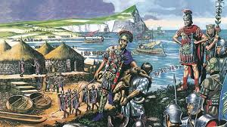
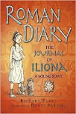
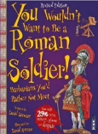
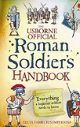
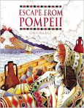
The Romans KS2 Knowledge Mat
Subject Specific Vocabulary |  |  | Exciting Books
centurion | A commander of a group of 100 Roman soldiers.
emperor | The Roman leader of the Roman Empire during the imperial period.
aqueduct | A large system, like a bridge, for carrying water from one place to another is called an aqueduct.
gladiator | A gladiator was an armed fighter who entertained audiences in the Roman Republic.
 |  | Sticky Knowledge about the Romans
 |  | Julius Caesar was probably the best known Roman leader. He extended the empire by invading other lands.
Londinium | This was the Roman name for London.
conquer | To overcome and take control of people or land using military force.
 |  | Boudicca was a queen of the British Celtic Iceni Tribe who led an uprising against the occupying forces of the Roman Empire.
invade | Enter a place or land with the intention of occupying it. | A legend tells that Rome was created by two brothers, Romulus and Remus who were abandoned after they were born. | Important Places
Romanisation | When the countries that the Romans conquered became very much like Rome. | Romans used to eat food like dormice dipped in honey. | Colosseum An oval amphitheatre in the centre of Rome which held up to 50,000 people. Hadrian’s Wall A long wall built by the Romans across the north of England. It was to keep out the Scots. It is now one of Britain’s most famous tourist attractions.
senate | Similar to the Roman version of our parliament. | Romans occasionally used a spoon, but they would never use a knife and fork. Rich Romans liked to eat exotic food, such as stork, roast parrot and even flamingo!
Roman baths | A number of rooms designed for bathing, relaxing, and socialising, as used in ancient Rome. | When the Romans came to Britain they helped us by creating roads; a written language (which was Latin); introducing coins and even introducing rabbits to our country.

Slide 3
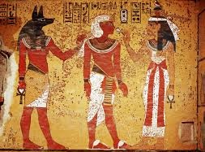
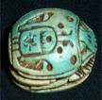
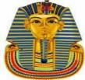
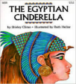
Ancient Egypt KS2 Knowledge Mat
Subject Specific Vocabulary |  |  | Egyptian Artefacts
archaeologist | People who discover our history by looking at artefacts that have been found.
pharaohs | The word pharaoh originally meant ‘great house’, but came to mean the person who resided in it.
tombs | Ancient Egypt is known for its magnificent and beautiful tombs. The most well known are within the pyramids in the Valley of the Kings.
pyramid | A geometrical term that refers to part of the burial complexes for Egyptian pharaohs.
hieroglyphs | The term hieroglyph refers to the fact that it is carving for sacred things, but hieroglyphs were also written on papyrus.
 |  | Sticky Egyptian knowledge
vizier | The vizier in ancient Egypt was the most powerful position after the king. A vizier was the equivalent of a modern day prime minister.
 |  | Cleopatra was the last pharaoh of Egypt before the Romans took over.
 |  |  | Exciting books
scribe | A scribe recorded in writing the everyday life and extraordinary happenings in ancient Egypt.
 |  | Tutankhamen was known as the boy king, famous because his tomb was found in 1922.
sarcophagus | Sarcophagus is a Greek word meaning flesh-eating and refers to the mummy case.
 |  | Egyptian men and women wore make-up.
mummy | Remains of a body found inside the carved and brilliantly painted burial case known as a sarcophagus.
 |  | The Egyptians were the first civilization to invent writing.
papyrus | An Egyptian plant whose reeds are slit and placed in layers in order to form paper.
scarab | Scarabs are amulets formed to look like the dung beetle, an animal associated by the ancient Egyptians with life, rebirth and the sun god Re.
scarab
sphinx
death mask

